Slide 1
Cluster Computing /Message Passing Programming Model
AMANO, Hideharu
Textbook pp.１４０－１４７

Slide 2
PC Clusters
PC Clusters
  A Cost efficient highly parallel systems
  Recently used in datacenters
Beowulf Clusters→A root of PC clusters
  Standard CPU boards, Standard components
  LAN+TCP/IP
  Free-software
  A cluster with Standard System Area Network(SAN) like Infiniband is also common.
Warehouse Scale Computers (Computing)
  A dedicated computer architecture for a large scale data center.
Notes:
PC Clusters are a cost efficient highly parallel systems which consist of a lot of PCs connected with high-bandwidth network. They were developed for an economical supercomputer, but recently, used for datacenters. Cloud computing is done on such clusters. One of a root of PC clusters is Beowulf clusters. It came from the name of NASA’s project to build a very cheap supercomputer. It used standard CPU boards and other standard components connected with LAN with TCP/IP. Free software is used for reducing the cost for the software. However, since the LAN with TCP/IP has a large latency, standard System Area Network or SANs like Infiniband are often used. Warehouse Scale Computers is a kind of large computer cluster, but the architecture is somehow dedicated to a large scale data center.

Slide 3
SAN (System Area Network) for PC clusters
Virtual Cut-through routing
High throughput/Low latency
Out of the cabinet but in the floor
Also used for connecting disk subsystems
  Sometimes called System Area Network
  Infiniband
  Myrinet
  Quadrics
GB Ethernet: 10GB/40GB/100GB Ethernet
  Store & Forward
  Tree based topologies
Notes:
System Area Network or SAN can use various types of techniques including virtual cut-through, virtual channels, and multicast. The topologies are not limited in a tree unlike Ethernet. It can support high thought with low latency compared to LAN. The area is in the floor, though the optical cables are introduced. Recent GB Ethernet has a high band-width, but the store and forward routing and tree based topologies are problems when they are used as network of PC clusters.

Slide 4
Infiniband
Point-to-point direct serial interconnection.
Using 8b/10b code.
Various types of topologies can be supported.
Multicasting/atomic transactions are supported.
The maximum throughput
 | SDR | DDR | QDR | HDR
1X | 2Gbit/s | 4Gbit/s | 8Gbit/s | 50Gbit/s
4X | 8Gbit/s | 16Gbit/s | 32Gbit/s | 200Gbit/s
12X | 24Gbit/s | 48Gbit/s | 96Gbit/s | 400Gbit/s
Notes:
This table shows the bandwidth of Infiniband. It is consisted of point-to-point serial interconnection and 8b/10b encoding is used. Recent bandwidth becomes huge.

Slide 5
Remote DMA (user level)
Local Node
Remote Node
System Call
Sender
Data Source
Data Sink
User
Kernel
Kernel
Agent
User
Level
Buffer
RDMA
Buffer
Host I/F
Protocol
Engine
Protocol
Engine
Network Interface
Network Interface
Notes:
User level remote Direct Memory Access is a frequently used technique in PC cluster. By using it, the data can transfer directly from the user area of a node to the user area of the other. Copy is only needed in the network interface.

Slide 6
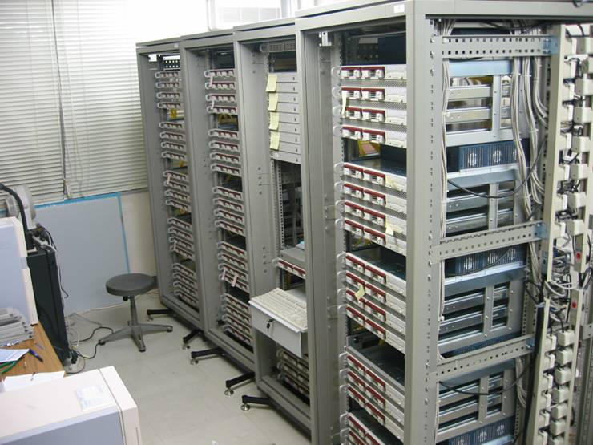
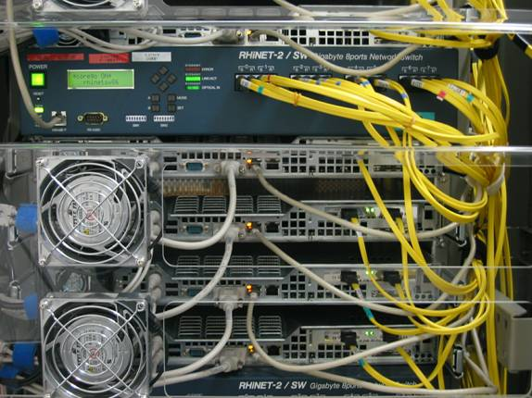
RHiNET Cluster
Node
CPU: Pentium III 933MHz
Memory: 1Gbyte
PCI bus: 64bit/66MHz
OS: Linux kernel 2.4.18
SCore: version 5.0.1
RHiNET-2 with 64 nodes
Network
Optical
Notes:
This is a PC cluster which we implemented. It uses optical interconnects instead of standard Infiniband.

Slide 7
What is WSC?
WSC (Warehouse Scale Computing)
  Google, Amazon, Yahoo,.. etc.
  A Large cluster with more than 50000 nodes
  It consisted of economical components
    Dedicated parts can be used.
  Reliability is kept by redundant structures and software.
  Power Supply and Cooling System are important design factor
Cloud Computing is supported with such WSCs.
Notes:
Google, Amazon and Yahoo use a large cluster with more than 50000 nodes for their datacenter. Hennessy and Patterson called such type of clusters Warehouse Scale Computing or WSC in their textbook. It consists of economical components, but special parts can be used since the number of nodes is huge. Reliability is kept by redundant structures and software. Power supply and Cooling System are important design factor of WSC.

Slide 8
Message Passing Model
No shared memory
Easy to be implemented in any parallel machines
Popularly used for PC Clusters
Today, we focus on MPI.
Notes:
Today, I would like to introduce the programming model of PC clusters. Since they don’t have shared memory, message passing library is used. It is called from common programming language like C or C++, and easy to be implemented in any parallel machine. MPI or message passing interface is the commonly used library.

Slide 9
Message passing
（Blocking: randezvous）
Send
Receive
Send
Receive
Notes:
The most fundamental way for message passing is blocking communication or randezvous. In this library, when the sender calls the send function and the receiver has not been arrived, the sender must wait. When receiver executes the function, both can go through. If the receiver executes the receive function earlier, it waits for the sender.

Slide 10
Message passing
（with buffer）
Send
Receive
Send
Receive
Notes:
By providing the message buffer, the sender can go forward without waiting for the receiver. However, when the reader executes earlier, it must wait. It is somehow unfair.

Slide 11
Message passing
（non-blocking）
Other Job
Send
Receive
Notes:
So, in MPI, when a receiver executes the receive function but the send has not arrived at the send function call, it can switch the process and execute other job for waiting time. This type of message passing is called non-blocking.

Slide 12
PVM (Parallel Virtual Machine)
A buffer is provided for a sender.
Both blocking/non-blocking receive is provided.
Barrier synchronization
Notes:
PVM or Parallel Virtual Machine is the first generation message passing library. Fundamental functions were provided. But, it was replaced by the upper compatible library MPI.

Slide 13
MPI
(Message Passing Interface)
Superset of the PVM for 1 to 1 communication.
Group communication
Various communication is supported.
Error check with communication tag.
Detail will be introduced later.
Notes:
MPI is a superset of the PVM in 1 to 1 message communication. It also has group communication and various communication with error checking and communicating tag.

Slide 14
Programming style using MPI
SPMD (Single Program Multiple Data Streams)
  Multiple processes executes the same program.
  Independent processing is done based on the process number.
Program execution using MPI
  Specified number of processes are generated.
  They are distributed to each node of the NORA machine or PC cluster.
Notes:
The programming style using MPI is SPMD or Single Program Multiple Data streams. That is the same program is executed in multiple nodes in parallel. Independent processing can be done based on the process number. They are distributed at each node of the NORA machines of PC clusters and executed in parallel.

Slide 15
Communication methods
Point-to-Point communication
  A sender and a receiver executes function for sending and receiving.
  Each function must be strictly matched.
Collective communication
  Communication between multiple processes.
  The same function is executed by multiple processes.
  Can be replaced with a sequence of Point-to-Point communication, but sometimes effective.
Notes:
The communication methods are classified into point-to-point communication and collective communication. In MPI, a sender and a receiver must be strictly matched.

Slide 16
Fundamental MPI functions
Most programs can be described using six fundamental functions
  MPI_Init() … MPI Initialization
  MPI_Comm_rank() … Get the process #
  MPI_Comm_size() … Get the total process #
  MPI_Send() … Message send
  MPI_Recv() … Message receive
  MPI_Finalize() … MPI termination
Notes:
This slide shows fundamental MPI functions used in this class. Actually, most programs can be described using these six functions.

Slide 17
Other MPI functions
Functions for measurement
  MPI_Barrier() … barrier synchronization
  MPI_Wtime() … get the clock time
Non-blocking function
  Consisting of communication request and check
  Other calculation can be executed during waiting.
Notes:
Other functions which can be used is barrier synchronization and get clock time.

Slide 18
A simple example: Hello
1: #include <stdio.h>
2: #include <mpi.h>
3:
4: #define MSIZE 64
5:
6: int main(int argc, char **argv)
7: {
8: char msg[MSIZE];
9: int pid, nprocs, i;
10: MPI_Status status;
11:
12: MPI_Init(&argc, &argv);
13: MPI_Comm_rank(MPI_COMM_WORLD, &pid);
14: MPI_Comm_size(MPI_COMM_WORLD, &nprocs);
15:
16: if (pid == 0) {
17: for (i = 1; i < nprocs; i++) {
18: MPI_Recv(msg, MSIZE, MPI_CHAR, i, 0, MPI_COMM_WORLD, &status);
19: fputs(msg, stdout);
20: }
21: }
22: else {
23: sprintf(msg, "Hello, world! (from process #%d)\n", pid);
24: MPI_Send(msg, MSIZE, MPI_CHAR, 0, 0, MPI_COMM_WORLD);
25: }
26:
27: MPI_Finalize();
28:
29: return 0;
30: }
Notes:
First, let me explain the simplest example Hello. This main is distributed to all processors.

Slide 19
Initialization and termination
int MPI_Init(
int *argc, /* pointer to argc */
char ***argv /* pointer to argv */ );
argc and argv come from command line like common C programming
int MPI_Finalize();
Example:
MPI_Init (&argc, &argv);
…
MPI_Finalize();
Notes:
First, we must initialize the MPI function by using MPI init. For finishing it, MPI finalize is used.

Slide 20
Communicators: a space for communication
MPI_COMM_WORLD is a communicator for all processes.
int MPI_Comm_rank(
MPI_Comm comm, /* communicator */
int *rank /* process ID (output) */ ); //Return process ID (rank)
int MPI_Comm_size(
MPI_Comm comm, /* communicator */
int *size /* number of process (output) */ ); //Return the number of all processes.
Example：
int pid, nproc;
MPI_Comm_rank(MPI_COMM_WORLD, &pid); // My process id
MPI_Comm_rank(MPI_COMM_WORLD,&nproc); // Total processor number
Notes:
For communication, a communicator is defined. It is a space for communication. Group communication can be done by using the communication, but here MPI COMM WORLD, a default communicator is used. MPI Comm rank gets the process ID called rank in MPI. MPI Comm size gets the number of all processes. They are variables needed for communication.

Slide 21
MPI_Send
1 to 1 message send
int MPI_Send(
void *buf, /* send buffer */
int count, /* # of elements to send */
MPI_Datatype datatype, /* datatype of elements */
int dest, /* destination (receiver) process ID */
int tag, /* tag */
MPI_Comm comm /* communicator */ );
MPI_Send(msg, MSIZE, MPI_CHAR, 0,0, MPI_COMM_WORLD);
Send MSIZE characters in the array “msg” to process 0 with tag 0.
MPI_Recv which matches the tag can receive the message.
Notes:
MPI send is for 1 to 1 message send. It uses the parameters shown here. The message is sent for the receiver whose number of destination and the tag are matched.

Slide 22
MPI_Recv
1 to 1 message receive
int MPI_Recv(
void *buf, /* receiver buffer */
int count, /* # of elements to receive */
MPI_Datatype datatype, /* datatype of elements */
int source, /* source (sender) process ID */
int tag, /* tag */
MPI_Comm comm, /* communicator */
MPI_Status /* status (output) */ );
char msg[MSIZE]
MPI_Status status;
MPI_Recv(msg, MSIZE, MPI_CHAR, 1, 0, MPI_COMM_WORLD, &status);
fputs(msg, stdout);
Receive MSIZE characters from process 1 with tag 0, and store in the array “msg”.、
“status” shows the status of receiving message.
Notes:
MPI Recv is a corresponding function to MPI Send. It also uses the parameters shown here. They are almost the same as those of MPI send, but the MPI status which holds the state of message passing is added.

Slide 23
datatype and count
The size of the message is identified with count and datatype.
  MPI_CHAR char
  MPI_INT int
  MPI_FLOAT float
  MPI_DOUBLE double … etc.
Notes:
MPI datatype is almost the same as that of type in C language.

Slide 24
Using MPI
login to the assigned ITC Linux machine
  If you use windows 10, open command prompt
  ssh login_name@XXXX.educ.cc.keio.ac.jp
Get the compressed file:
  wget http://www.am.ics.keio.ac.jp/comparc/mpiexg.tar
  tar xvf mpiexg.tar
  cd mpi
https://keio.box.com/s/uwlczjfq4sp73xsni2c1y4vbwrk3ityp
Notes:
Then, let’s use MPI. First, you should login ITC Linux machines and get the tar file.

Slide 25
Compile and Execution
% mpicc –o hello hello.c
% mpirun –np 4 ./hello
Hello, world! (from process #1)
Hello, world! (from process #2)
Hello, world! (from process #3)
Notes:
The compile and execution are done with mpicc and mpirun respectively. –np specifies the number of executing nodes. The number must be smaller than those of node numbers in the system.

Slide 26
Example2 reduct.c: Initialize
int pid, nproc, i;
FILE *fin;
double mat[N];
double sum, psum;
double start, startcomp, end;
MPI_Status status;
if((fin = fopen("mat4k.dat", "r"))==NULL) {
fprintf(stderr, "mat.dat is not existing\n");
exit(1);
}
MPI_Init(&argc, &argv);
MPI_Comm_rank(MPI_COMM_WORLD, &pid);
MPI_Comm_size(MPI_COMM_WORLD, &nproc);
mat4k.dat has the data
MPI Initialize
Notes:
Let me show another proactical example called reduct.c It computes the reduction calculation. Fisrt of all. data are loaded from the file and MPI is initialized.

Slide 27
reduct.c: host (pid=0)
sum=0.0;
if (pid == 0) {
for (i = 0; i<N; i++) { fscanf(fin,"%lf", &mat[i]); }
start = MPI_Wtime();
for (i = 1; i < nproc; i++)
MPI_Send(&mat[i*N/nproc], N/nproc, MPI_DOUBLE, i, 0, MPI_COMM_WORLD);
startcomp = MPI_Wtime();
for(i = 0; i < N/nproc; i++) sum += mat[i];
for (i = 1; i < nproc; i++) {
MPI_Recv(&psum, 1, MPI_DOUBLE, i, 0, MPI_COMM_WORLD, &status);
sum += psum;
}
end = MPI_Wtime();
printf("%lf\n", sum);
printf("Total time = %lf Exect time= %lf [sec]\n", end-start, end-startcomp);
}
Read data from the file
MPI send
Compute its own part.
Notes:
Here is a program of the host, that is pid = 0. It reads the data from the file and distributes to node 1-3. Then it computes its own part. After computation, it receives the result of computation from node 1-3, and adds into its own result.

Slide 28
Distribution of data in the array
0
N/nproc
2*N/nproc
3*N/nproc
host pid=0
reduction
pid=1
reduction
pid=2
reduction
pid=3
reduction
Notes:
In this case, the host divides and distributes the array to other nodes.

Slide 29
reduct.c: slave processors
Receive data
else {
i=0;
MPI_Recv(&mat[i], N/nproc, MPI_DOUBLE, 0, 0, MPI_COMM_WORLD, &status);
for(i = 0; i< N/nproc; i++) sum += mat[i];
MPI_Send(&sum, 1, MPI_DOUBLE, 0, 0, MPI_COMM_WORLD);
}
MPI_Finalize();
return 0;
}
Partial sum
Send the result
to host
Notes:
Node 1-3, receives the part of array, and computes the sum of them. The result is returned to the host.

Slide 30
Example3: ssum.c
Assume that there is an array of coefficient x[4096].
Write the MPI code for computing sum of square of difference of all combinations.
sum = 0.0;
for (i=0; i<N; i++)
for(j=0; j<N; j++)
sum += (x[i]-x[j])*(x[i]-x[j]);
Notes:
Another example has double loops.

Slide 31
Parallelization Policy
Distribute x to all processors.
Each processor computes partial sums.
  sum=0.0;
  for (i=N/nproc*pid; i<N/nproc*(pid+1); i++)
  for(j=0; j<N; j++)
  sum += (x[i]-x[j])*(x[i]-x[j]);
  Then, send sum to processor 0.
Note that the computation results are not exactly the same.
Notes:
In this case, all elements of the array is distributed.

Slide 32
Distribution of data in the array
0
N/nproc
2*N/nproc
3*N/nproc
host pid=0
Compute
pid=1
Compute
pid=2
Compute
pid=3
Compute
Distribute the whole array
Compute only a part
Return the computed part
Notes:
All nodes compute its own part and the whole array. It takes some time to compute it.

Slide 33
Exercise: CG method
Parallelize only the part of A x p.
  Other parts can be parallelized, but the performance is not improved.
MPI supports MPI_Bcast, MPI_Reduce which can be used for the program.
  I tried to use them, but the performance was severely degraded.
  Challengers can use them, but I don’t recommend.
Notes:
OK. Our example is conjugate gradient method to solve a large matrix. Parallelize only part of Axp which occupies a large part of the computation time.

Slide 34
Report
Submit the followings to keio.jp:
  MPI C source code.
  The results executed with 2,3, and 4 threads.
Notes:
The report should be submitted to keio.jp, not hunga4125@gmail.com as the case of OpenMP.

