Slide 1
Techniques for packet transfer in parallel machines
AMANO, Hideharu
Textbook pp.１６６－１８５
Notes:
I have introduced direct and indirect networks. But, the techniques for packet transfer is more important for high speed data interchange.

Slide 2
Centralized interconnection networks
Symmetric:
  MIN (Multistage Interconnection Networks)
  Each node is connected with equal latency and bandwidth
Asymmetric:
  Fat-tree, base-m n-cube, etc.
  Locality of communication can be used.
Notes:
Next, let me explain asymmetric network. They have been used because of its high bandwidth and the property which can use the locality of communication.

Slide 3
Asymmetric indirect networks
Intermediate position between direct interconnection network and MINs
High communication capability considering cost
  base-m n-cube（Hyper crossbar）
    SR2000、CP-PACS
  Fat Tree
    CM-5，Some WS Clusters
  Hyper-cross
    ADENART
Notes:
Asymmetric indirect networks are at intermediate position between direct interconnection network and MINs. It can achieve high communication capability considering their cost. So, they have been used in real machines.

Slide 4
base-m n-cube
(Hyper crossbar)
crossbar
router
PU
Used in Toshiba’s Prodigy and Hitachi’s SR8000
Notes:
Base-m n-cube uses crossbar instead of direct links of k-ary n-cube. This diagram shows the 2 dimensional one, but it can be extended like k-ary n-cubes. It was used in Toshiba’s Prodigy and Hitachi’s SR8000. Also, similar concept is used in the network of FPGAs.

Slide 5
HyperCross
(pi,pj)→ (pj,*),(*,pi)
0,0
0,3
Xbar
Xbar
Xbar
3,0
3,3
Used in ADENART by Matsushita
Notes:
Hyper Cross network is interesting network to use the crossbars. A node labeled with pi,pj is connected with pj.* and *,pi with crossbars. It was used in Matsushita’s supercomputer.

Slide 6
Fat Tree
Fat tree is defined with (p,q,r) where p: num. of upper links, q: num. of lower links
r: num, of hierarchy, This example is FT(2,4,2)
Notes:
Fat tree is different from a tree of the direct network in two points. First, the intermediate nodes are switching elements, and computational nodes are only allocated in the leaves. Second, it is consisted of duplicated tree structure. Fat tree is defined with p,q,r where p is the number of upper links, q is the number of lower links and r is the number of the hierarchy. This example shows 2,4,2.

Slide 7
Return paths with MIN = Fat tree
Notes:
When we provide return paths in MINs, it becomes a fat tree. It is Generalized cube but by providing the U-turn paths, it becomes fat tree (2,2,4)

Slide 8
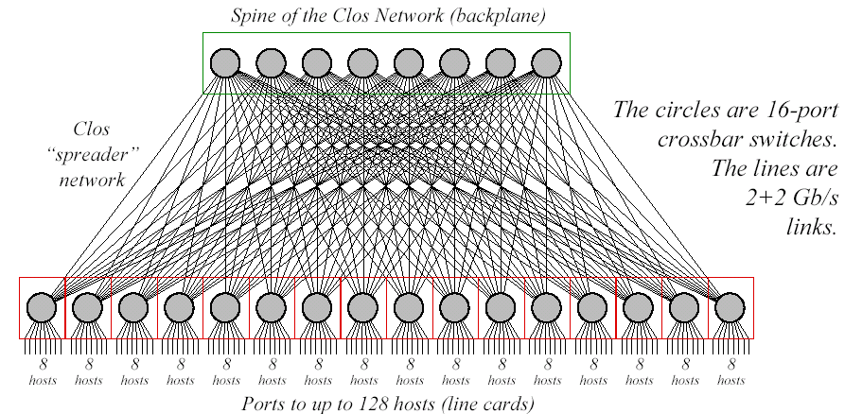
Myrinet-Clos（１/2)
１２８nodes(Clos128)
Notes:
Myrinet-Clos or some network called Clos is not actually Clos network but hypercube. Clos means the way to connect switches that there is a link for every switch in the different stage.

Slide 9
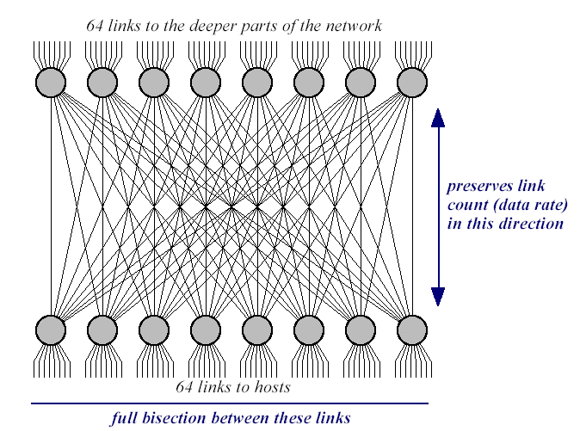
Clos64+64
Notes:
This structure shows a variation of the fat tree.

Slide 10
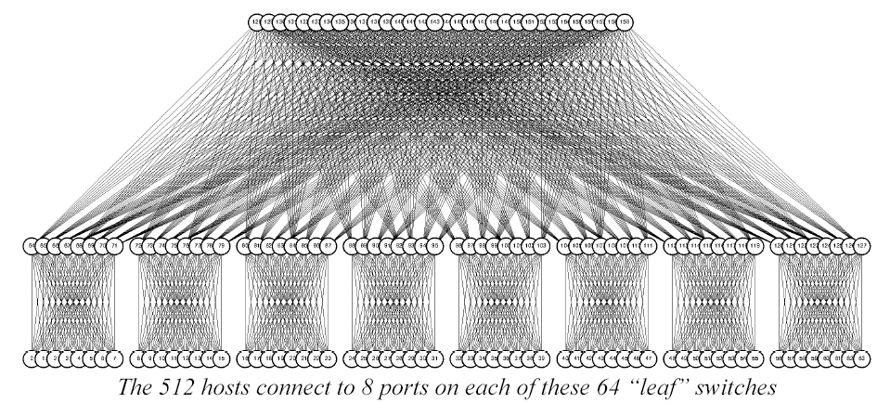
Myrinet-Clos(2/2)
512nodes
Notes:
It can connect a lot of nodes. Most of clusters use this kind of high-p and q fat trees. This is because a switching fabric with a large number of inputs / outputs can be easily used recently. They are sometimes called a high-radix network.

Slide 11
Flattened butterfly
router (2×2)
router
(5×5)
2-ary 4-fly
2⁴=16 node
2-ary 4-flat
2⁴=16 node
A row of MIN is fused. High radix → High bandwidth
Multiple paths can be formed
Notes:
Flattened butterfly is formed by fusing multiple switching elements of generalized cube network. This example shows to connect 32 nodes.
11

Slide 12
Dragonfly
…
…
…
global channels
Intra-group int. network
R0
R1
．．．
Rn-1
Inter-group int. network
…
…
…
terminal channels
…
G0
G1
Gg
…
…
…
P0
P1
Pk-1
Pk
Pk+1
P2k-1
PN-k-1
PN-k
PN-1
Notes:
Dragonfly is based on the similar concept of hierarchical networks of direct networks. A part of links to form a intra-group interconnection network can be used to form an inter-group network. Usually, the inter-group interconnection network is complete interconnection.

Slide 13
G1
G2
G8
……
An example of Dragonfly
(N=72)
G0
R0
R1
R2
R3
The interconnection of
this part can be Flatten Butterfly
P0
P1
P2
P3
P4
P5
P6
P7
Notes:
In this example, interconnection of the internal group is also complete interconnection. Two links from a switch are used to form complete interconnection between other groups.

Slide 14
4x24 Full mesh Connected Cycles (FCC)
24 Cycles are
connected
in full-mesh
6x4
6x4
…
…
2..7
2..7
1
0
x4
0
1
……
x4
x4
x4
1
0
0
1
2..7
2..7
…
…
6x4
6x4
96 boards are connected
Notes:
This is another example of Dragonfly. In this case, a simple ring is used to form an inner-group network.

Slide 15
Summary: k-ary n-cube vs. high radix
Sorry. This figure is not based on accurate data.
supercomputers
k-ary
n-cube
high radix
clusters/data centers
high radix
k-ary n-cube
NoCs
Now, they dominate the world of Interconnection Networks
Notes:
I am sorry but this graph is not based on accurate data. In supercomputers, high radix networks like fat tree or dragonfly and direct interconnection of k-ary n-cubes are popularly used. In computer cluster or data centers, high radix network is major, although for NoCs, k-ary n-cube are popularly used. This is also today’s summary

Slide 16
Packet transfer
Body
Tailer: CRC etc.
destination
length，source，etc．
8bit~64bit
Header
Flit
Packet switching
Circuit switching
Flit： Atomic unit for packet transfer
Flit width is not always link width.
Notes:
The data transfer in parallel machines is classified into two methods: packet switching and circuit switching. The former method sends small data unit called a packet, while the latter method makes a circuit between a source node and destination node. Most machines use a packet switching because of its high efficiency. A unit data transferred in packet is called a flit. It is corresponding to word in a computer. A packet consists of header flits, body flits and tailor flits. Header carries information for the routing, for example, destination, length and source. The body carries data, and tailor includes error correcting code or information.

Slide 17
Packet transfer method
Store and Forward
  Entire packet is stored in the buffer of each node
  TCP/IP protocol must use it
Wormhole routing
  Each flit can go forward as possible
  If the head is blocked, entire packet is stopped.
Virtual Cut Through
  If the head is blocked, the rest of packet is stored into the buffer in the node.
Notes:
There are three methods. Store and forward, wormhole routing and virtual cut through.

Slide 18
Store and Forward
All flits of packet are stored into the buffer in the node.
Large latency D(h+b)
Large requirement of buffer
Re-transmission of faulty packets can be done by the software
(TCP/IP uses this method)
Notes:
In the store and forward routing, all flits of packet are stored into the buffer in every node. So, the latency becomes large. It becomes diameter by the total packet size, h for the header and b for the body. The buffer requirement is also large. However, node to node error check and re-transmission can be by software. That is, TCP/IP uses this method.

Slide 19
Wormhole
4
3
4
2
3
1
2
1
The head of the packet can go as possible
Small latency hD+b
Small buffer requirement
Hardware router is required.
Notes:
In the wormhole routing, the head of the packet can go as possible. The latency is small, it becomes h by D plus b. Since buffer only for the header is required, the total buffer requirement is small. It cannot be managed by software, that is, hardware router is required.

Slide 20
Wormhole
2
4
1
3
2
1
The head of the packet can go as possible
Small latency hD+b
Small buffer requirement
Hardware router is required.
Notes:
The header can go forward as possible.

Slide 21
Wormhole
4
3
2
1
The head of the packet can go as possible
Small latency hD+b
Small buffer requirement
Hardware router is required.

Slide 22
Wormhole
4
3
2
1
The head of the packet can go as possible
Small latency hD+b
Small buffer requirement
Hardware router is required.
Notes:
In this method, once a packet is blocked it occupies buffers of a lot of nodes.

Slide 23
Virtual Cut Through
4
3
4
2
3
1
2
1
If blocked, the rest of packet is stored in the buffer
The same latency as Wormhole
The same buffer requirement as Store and Forward
Hardware router is required.
Notes:
In virtual cut through routing, all nodes have buffer for storing a packet as store-and-forward. But, the header can go forward as possible like wormhole routing. When the header is blocked, the rest of packet is stored in the buffer.

Slide 24
Virtual Cut Through
4
3
2
1
If blocked, the rest of packet is stored in the buffer
The same latency as Wormhole
The same buffer requirement as Store and Forward
Hardware router is required.

Slide 25
Virtual Cut Through
4
3
2
1
If blocked, the rest of packet is stored in the buffer
The same latency as Wormhole
The same buffer requirement as Store and Forward
Hardware router is required.

Slide 26
Virtual Cut Through
4
3
2
1
If blocked, the rest of packet is stored in the buffer
The same latency as Wormhole
The same buffer requirement as Store and Forward
Hardware router is required.

Slide 27
Virtual Cut Through
4
3
2
1
If blocked, the rest of packet is stored in the buffer
The same latency as Wormhole
The same buffer requirement as Store and Forward
Hardware router is required.

Slide 28
Virtual Cut Through
4
3
2
1
If blocked, the rest of packet is stored in the buffer
The same latency as Wormhole
The same buffer requirement as Store and Forward
Hardware router is required.

Slide 29
Virtual Cut Through
4
3
2
1
If blocked, the rest of packet is stored in the buffer
The same latency as Wormhole
The same buffer requirement as Store and Forward
Hardware router is required.

Slide 30
Virtual Cut Through
4
3
2
1
If blocked, the rest of packet is stored in the buffer
The same latency as Wormhole
The same buffer requirement as Store and Forward
Hardware router is required.

Slide 31
Virtual Cut Through
4
3
2
1
If blocked, the rest of packet is stored in the buffer
The same latency as Wormhole
The same buffer requirement as Store and Forward
Hardware router is required.
Notes:
Unlike the wormhole routing, buffer in the only one node is occupied when the packet is blocked.

Slide 32
LAN,Component networks/SAN and Network on Chip
LAN(Local Area Network):
  Store and Forward
Component network/ SAN(System Area Network):
  The first generation NORA uses store and forward method.
  Recent Component networks/SANs:
    For large packets: Wormhole
    For multicast: Virtual Cut Through
  Infiniband
Network on Chip:
  Wormhole
Notes:
Three packet forwarding methods are used for appropriate type of interconnection network. LAN or local memory network uses TCP/IP, that is store and forward. Component network and system area network used store and forward first, but wormhole or virtual cut through is used. For example, Infiniband uses the virtual cut through is used. For Network on chip, the wormhole routing is mainly used.

Slide 33
Qiuz
A packet with 1 flit header and 15 flits body is transferred on a 4-ary 2-cube. Compute the largest number of clocks when it is sent with Store-and-Forward manner, and compared with the case when Wormhole method is used. Ignore the delay caused by congestion.
Notes:
Here is a simple quiz.

Slide 34
A problem of Wormhole
Notes:
The problem of wormhole routing is that buffer in a lot of nodes are blocked by a packet. In this example, the destination buffer of the green packet is empty, but blocked because no buffer can be used in this node.

Slide 35
Virtual Channel
By providing a bypass
buffer, channel is provided
virtually.
Notes:
If there is reserved buffer for each direction, this green packet can go forward.

Slide 36
Implementation of Virtual Channel
It wants to turn right, but impossible
Wasted Bandwidth
The lane for turning right
Notes:
This idea is called the virtual channel. It is somehow like the dedicated lane for turning right. This car wants to turn right, and the target road is empty, but it is impossible to go.
If the lane for turning right is provided, the car can turn right.

Slide 37
Implementation of Virtual Channel
Wasted Bandwidth
VC → Providing another lane
  But the physical wires are not increased.
[Dally,TPDS’92]
Packet (a)
VC#0
Packet (b)
VC#1
Notes:
In order to do it, virtual channel provides independent channels. When this channel is blocked, another packet can go forward using the other channel. Note that the physical wires are not increased, but used in time multiplexing manner when not used by the blocking.

Slide 38
Handshake of Virtual Channel
NODE
Handshake line
Ｂｕｆｆｅｒ
Link
Handshake line
Crossbar
Ｂｕｆｆｅｒ
MUX
Notes:
In order to implement virtual channel, handshake mechanism is needed. That is, the information whether the buffer is empty or not must be transferred independently.

Slide 39
An example of a modern router
WH router with two virtual channels
ARBITER
X+
FIFO
X+
X-
FIFO
X-
Y+
FIFO
Y+
Y-
FIFO
Y-
5x5 XBAR
CORE
FIFO
CORE
Notes:
This shows an example of a modern router. There are two buffers for two virtual channels. Here, 5x5 router for two dimensional mesh is assumed. Core means the connected computing node. 5x5 crossbar and arbiter are provided.

Slide 40
Pipelined operation
It takes three clocks to pass through the switch
  RC (Routing Computation)
  VSA (Virtual Channel / Switch Allocation)
  ST (Switch Traversal)
@ROUTER A
@ROUTER B
@ROUTER C
HEAD
RC
VSA
ST
RC
VSA
ST
RC
VSA
ST
DATA 1
ST
ST
ST
DATA 2
ST
ST
ST
DATA 3
ST
ST
ST
1
2
3
4
5
6
7
8
9
10
11
12
ELAPSED TIME [CYCLE]
Notes:
The packet is transferred in the pipelined manner. This example uses three stages: routing computation, virtual channel and switch allocation stage, and switch traversal.

Slide 41
Deadlock avoidance
Blocking destination buffer each other
To solve it
→ Eliminate cyclic dependency between buffers
Notes:
Next, let me explain the problem of the deadlock. It is caused when each target buffer is blocked by each other. The red packet wants this buffer, the blue one wants this, but the green one wants this. So, they are mutually blocked. This happens when the dependency of buffer requirement forms a cycle. In order to solve it, we must eliminate cyclic dependency between buffers.

Slide 42
Structured buffer pool
1
2
0
3
Packet is sent to Buf#＋１
No cyclic dependency between buffers
Structured channel for Wormhole
Notes:
Structured buffer pool is a basic method to solve the deadlock. It provides a plenty of buffers, and the packet is sent to the buffer number+1. That is, this packet is transferred to buffer 1, then 2, and 3. Apparently no cyclic dependency between buffers is formed. However, it requires D+1 buffers where D is the diameter. The same concept can be used for the virtual channel. It is called a structured channel.

Slide 43
Dimension order (e-cube) routing：DOR
Dedicated buffers
are provided for each
direction.
Ｗ
Ｓ
Ｎ
Ｅ
The fixed order:
W→S→E→N
No cyclic dependency
Notes:
Dimension order routing or DOR fixes the order of dimension to be used. For example, first use x direction then use y direction. Of course, dedicated buffers are provided for each direction.

Slide 44
Dimension order routing
Once the direction is changed,
it cannot be used again.
Ｗ
Ｓ
X
Notes:
Dimension order routing does not allow to use the dimension again after using other dimension. That is, to use this dimension is forbidden.

Slide 45
DOR for torus
Packet A
Packet B
Single direction packet transfer also makes a cyclic dependency
Notes:
The DOR is guaranteed deadlock free in the mesh network. But, in the torus with wrap-around links, the cyclic dependency is formed even if the rule of kept.

Slide 46
DOR for torus
1
1
1
０
０
０
０
０
Virtual channel number is changed when the round trip
link is used.
Notes:
To solve it, virtual channel number is switched when the round trip link is used. With this simple rule, the DOR can be used. The DOR can be applied any structure of k-ary n-cube.

Slide 47
Glossary 1
Flit:パケットの基本（最小）転送単位、必ずしもリンクのビット幅と等しい必要はないが、これ以上細かいデータ単位で転送を制御することはできないもの
Wormhole routing:いも虫が穴を開けながら進んで行く様子から出た単語。日本語でもこのまま読む。
Virtual Cut through:仮想的にパケットが突き抜けたように見えることから出た単語。日本語でもこのまま読む
Virtual Channel:仮想チャネル。バッファとハンドシェークラインを独立に用意することで、仮想的に複数の転送チャネルを実現する。リンクの利用率を上げ、デッドロックを防ぐ。
Deadlock:すくみ、デッドロック、パケットが用いるバッファがCyclic dependency（互いに循環的にバッファを要求すること）を生じることにより、先に進めなくなる現象
Structural buffer pool：構造化バッファ法、デッドロックを防ぐための古典的な手法
Notes:
This is the glossary of the first segment.

Slide 48
Adaptive routing
A fixed path is used, and not changed dynamically.
  Fixed/Deterministic routing
A path is dynamically changed in order to bypass the congested point (hot spot).
  Adaptive routing
  However, deadlock should be avoided.
Notes:
When a fixed path between source and destination is always used, it is called a fixed or deterministic routing. On the contrary, a path is dynamically changed in the adaptive routing in order to bypass the congested point or hot spot. The challenge is to avoid to make a cyclic dependency selecting adaptive paths.

Slide 49
Adaptive routing techniques
Using sub-networks
  double-Y routing
  Planner Adaptive routing
Using virtual channels
  Dimension reversal routing
  ＊channel (Duato’s Protocol)
Probability based methods
  Chaos routing
Restrict the direction of paths
  Turn model
Notes:
For avoiding the deadlock, there are several methods, to use sub-networks or to use virtual channels. This chaos routing is interesting method to use the probability. The last one is by restricting the direction of paths.

Slide 50
double Y routing
+X subnet
-X subnet
Using virtual channels, a network is
divided into two sub-networks.
Cyclic redundancy can be eliminated
if a packet uses only a sub-network.
Notes:
In this double Y routing by using virtual channels, a network is divided into two sub-networks. +X subnet and –X subnet. If a packet uses only a sub-network in a direction, the deadlock never happens.

Slide 51
Dimension reversal routing
Providing N virtual channels, and start from channel N.
DOR-cube routing is basically used.
When the packet is routed to the direction which is forbidden in the DOR routing, then decrement the virtual channel number.
On channel 0, DOR is strictly used.
Notes:
Dimension reversal routing uses N virtual channels, and starts from channel N. DOR routing is basically used, and when the packet is routed to the direction which is forbidden in the DOR routing, then decrement the virtual channel number. On the channel 0, DOR must be used, that is it is not an adaptive routing anymore.

Slide 52
Dimension reversal routing
When a packet goes
to irregular direction,
the virtual channel
number is decremented.
Ch.2
Ch.2
Ch.1
Ch．0 must use DOR
routing
Ch.1
Ch.1
Ch.0
Notes:
This is an example of dimension reversal routing. When a packet goes to irregular direction, the virtual channel number is decremented.

Slide 53
Ｔｕｒｎ ｍｏｄｅｌ: Motivation
DOR routing which allows only W→S→E→N
W
E
Ｘ
Ｘ
Ｘ
S
N
N
S
E
W
Ｘ
DOR routing forbids too many turns.
Cycles can be broken with less forbidden turns.
Notes:
The DOR routing decides the order of turn strictly. That is, it forbids too many turns. In order to break the cycle, less forbidden turns are enough. Turn model tries to find the minimum set of the forbidden turns.

Slide 54
Forbidden turns must be set considering complex combinations
Ｘ
Ｘ
Ｘ
Ｘ
A Cycle is formed
with a combination.
Notes:
We must take care of complex combinations of multiple cycles. For example, the combination of these forbidden turns still forms this cycle.

Slide 55
Deadlock free set of forbidden turns
Ｘ
Ｘ
Ｗｅｓｔ Ｆｉｒｓｔ
Ｘ
Ｘ
Ｎｏｒｔｈ Ｌａｓｔ
Notes:
West first routing forbids these two turns. That is, west direction cannot go after turning. It means the west must be selected first. In north last routing, once the north direction is selected, it cannot turn any direction. That is the north must be selected last. However, they still have room of changing direction unlike the DOR.

Slide 56
Congestion avoidance with Ｗｅｓｔ Ｆｉｒｓｔ
Ｘ
Ｎ
Ｗ
Ｅ
Ｓ
Once a packet goes to West and turns, it cannot go again.
Notes:
Assume that this link is faulty or congested. We must bypass the node by using the west first method. Note that the turn model is non-minimal routing which can select non-minimal paths.

Slide 57
Ｄｕａｔｏ’ｓ Ｐｒｏｔｏｃｏｌ
（*-channel）
ＣＡ０
Ｅｓｃａｐｅ Ｐａｔｈ
ＣＡ３
ＣＡ１
ＣＡ２
Notes:
Duato’s protocol or *-channel makes the best use of virtual channels. By using the VC, two paths are provided. The adaptive path and the escape path. The adaptive path can have a cyclic path but the escape path must include the all nodes but be deadlock free. The move from adaptive path to escape path is free. If adaptive path causes the deadlock, it moves the escape path. Since escape path is deadlock free, the deadlock on the adaptive path will be solved anyway.

Slide 58
Minimal routing [F.Silla,1997]
Escape Paths
Src
Dst
Adaptive Paths
Overall the network, a path without cycle is provided.
(Escape path)
A packet can be moved from Adaptive path to Escape path at any node.
Once a packet uses Escape path, it cannot go back to Adaptive path
Notes:
The condition is as follows. Escape path must be overall the network and without cycle. Also, a packet can be moved from adaptive path to escape path at any node. Once a packet uses Escape path, it cannot go back to the adaptive path.

Slide 59
Adaptive routing for Irregular networks: Up*/Down* routing
Typical partially adaptive routing
Eliminates a channel cyclic-dependency in order to avoid deadlock.
Algorithm:
  Build a spanning-tree.
    BFS(Breadth First Search)
    DFS(Depth First Search)
  Build an up/down directed-graph.
  Set a restriction to avoid the deadlock.
Notes:
Irregular networks have no regular to build the topology. The up*/down* routing is a famous adaptive routing used in any network. First, a spanning tree is built. Both breadth first search and depth first search can be used. Then an up/down direction is attached. By restricting the turn from down to up direction, the deadlock is avoided.

Slide 60
Building an up*/down* directed graph
1. Select a root node.
a. Up direction
2. Add the rest nodes to the tree.
destination node is closer to the root node.
3. Allocate the direction (up or down) for each channel.
b. Down direction
0
depth 0
4
4
Bi-directional channel
2
1
2
1
1
2
Spanning tree
depth 1
0
3
0
3
6
Root
6
5
5
3
4
5
6
depth 2
7
7
8
8
depth 3
7
8
Notes:
Spanning tree can be built as follows. First, select a root node, and add other nodes to the shape of the tree. Then, the direction is attached to each link. Up direction is attached to the link when the destination node is closer to the root node. Down is attached to the opposite direction.

Slide 61
Up*/Down* routing algorithm
After using up channel(if any),
use down channel(if any).
Non-minimal partially adaptive routing
A cyclic dependency between up and down channels is broken.
deadlock-free
0
up channel
1
2
down channel
3
4
5
6
Up
7
8
Down
Notes:
The rule is simple. Aflter using up channel, use down channel. Assume that the source node is 3 and the destination node is 6. In this case, first, the packet must go to up direction and then go to down direction. The shorter, alternative route is not allowed to be used. Although a cyclic dependency is broken, it is non-minimal routing.

Slide 62
Drawbacks of up*/down* routing
Many forbidden turns are concentrated on certain leaf nodes.
Congestion around root node.
Improvement proposals
  Using DFS tree
  Introducing another dimension
Notes:
The up/down routing is general way, but there are following drawbacks. That is many forbidden turns are concentrated on certain leaf nodes. Congestion around the root node is another problem. Improvement methods have been investigated.

Slide 63
Researches on adaptive routing for regular networks
Ｄｕａｔｏ’s Ｐｒｏｔｏｃｏｌ or Turn model is mostly used.
For irregular networks, up*/down* routing is also popular.
Deadlock detection and drop protocol vs. deadlock free routing.
Notes:
Recently, Duato’s protocol or turn model is mostly used for regular networks. For irregular network, up/down routing is popularly used.

Slide 64
Summary: adaptive routing
Drawbacks:
  FIFO assumption is not guaranteed.
  Difficult to debug, if trouble occurs.
However, the benefits will overcome the drawbacks.
Recent high performance networks use adaptive routing.
Notes:
Let’s make a summary.

Slide 65
Exercise
For an irregular network shown below:
  Pick up a node as a root node and draw a spanning tree.
  Add up/down direction to each link.
  Show the longest path between a source and destination node.
L
E
F
H
A
K
B
D
G
J
C
Notes:
Today’s exercise is very simple.

Slide 66
Glossary2
Adaptive routing:適応型ルーティング。ネットワークの混雑状況に応じて動的に経路を変えるルーティング。変えることができない方法をDeterministic routing（固定ルーティング）と呼ぶ。
  経路を勝手に変えるとデッドロックしてしまうので、様々な方法が提案されている。Double Y Routing、Dimension Reversal Routing,Turn model, Duato’s protocolは、全てこの方法の名前。
  Minimal routingつまり最短経路を必ず選ぶ方法と、non-minimal routing最短経路でなくても迂回可能な方法がある。
SAN(System Area Network): PCクラスタなどで用いられるネットワーク、代表選手はMyrinet、QsNet。ちなみにサーバー屋さんは、SANを（Storage Area Network)のことだと思っているので注意。
Irregular Network:不規則なネットワーク、多くのSANでは規則的ではなく、不規則なネットワークを許容する。これはPCクラスタなどでは、場合に応じて、ノードが欠けたりするため。

