Slide 1
Reconfigurable Architectures
AMANO, Hideharu
hunga＠am．ics．keio．ac．jp

Slide 2
Reconfigurable System （Custom Computing Machine）
A target algorithm is executed directly with a hardware on SRAM-style FPGA/PLDs.
High performance of special purpose machines.
High degree of flexibility of general purpose machines.
A completely different execution mechanism from stored program computers.
Notes:
Unlike common computers, in reconfigurable systems or custom computing machines, a target algorithm is executed directly with a hardware on SRAM-style FPGA/PLDs. It can provide both high performance of special purpose machines and high degree of flexibility of general purpose machine. That is to learn about reconfigurable systems is to learn hardware algorithms.

Slide 3
What is PLD(Programmable Logic Device)?
Integrated Circuit whose logic function can be defined by users.
↔ Standard ＩＣ，ＡＳＩＣ(Ａｐｐｌｉｃａｔｉｏｎ Ｓｐｅｃｉｆｉｃ ＩＣ）
ＳＰＬＤ（Simple PLD) / ＰＬＡ（Programmable Logic Array)
Small scale IC with AND-OR array
ＣＰＬＤ(Complex PLD)
Middle scale IC with AND-OR array
ＦＰＧＡ（Ｆｉｅｌｄ Ｐｒｏｇａｒｍｍａｂｌｅ Ｇａｔｅ Ａｒｒａｙ）
Large scale IC with LUT
Notes:
First of all, let’s review programmable logic devices or PLDs quickly. It is an integrated circuit whose logic function can be defined by users. It is an opposite concept as that of standard IC or ASIC which cannot change its hardware. It is classified into small SPLD or PLA, middle scale Complex PLD and FPGAs. Though SPLD and CPLD are still used in some specific area, FPGAs are most popularly used recently.

Slide 4
Rapidly development of PLD
Gate number
Increasing Performance
From 1991-2000
Amount of gate: X45
Speed: X12
Cost:1/100
10M
1M
Anti-fuse
FPGA
SRAM-
FPGA
Hierarchical structure
Embedded Core
Low voltage
100K
CPLD
EEPROM-
SPLD
Fuse-
PLA
10K
1980
1990
2000
Notes:
The first PLDs used in 1970’s were fuse type programmable logic array. Since the program is done by breaking fuses, it is programmable only once. In mid 80’s, EEPROM style SPLD called GALs which is rewritable were popularly used. FPGAs appeared in the early 90’s. It grew up rapidly until now.

Slide 5
LUT：Look Up Table
Look Up Table
ROM/RAM
Address
Data
…
…
A simple ROM/RAM can used as a
random logic.
C
B
ABC
Z
Z
０
A
０００
０
００１
０
０
０１０
０
０
０１１
１
１
１００
０
０
１０１
０
０
A combination of memory and
multiplexers are commonly used.
１１０
０
０
１１１
１
１
Notes:
A simple ROM or RAM can be used as a logic circuit by storing truth table and reading it by address as inputs of the circuits. However, since the common memory focuses on the storing data as much as possible, it is not efficient when used for truth table. Instead, a small register and a tree of multiplexer is advantageous considering both speed and cost. This structure is called a look up table or LUT.

Slide 6
An example using LUT：Look Up Table
1 1 0
C
B
ABC
Z
Z
０
A
０００
０
００１
０
０
０１０
０
０
1
０１１
１
１
１００
０
０
１０１
０
０
１１０
０
０
１１１
１
１
Notes:
Each multiplexer shares the control signal in each hierarchy, and the lower input is selected when 1 is given, while the upper input is selected when 0 is given. You can easily see that the table is referred with this mechanism.

Slide 7
FPGA(Field Programmable Gate Array)
LUT
Connection Block
F.F
Configurable Logic
Block
island style
Switch
Block
LUT and interconnection
is decided with
configuration data
IOB
Notes:
This diagram shows the island style FPGA. Two LUTs and Flip flops form a unit of logic called configurable logic block or CLB. They are distributed in the sea of wires. At the intersection of wires and the input/output of CLB, there are switch blocks consisted of simple MOS FET. If they are ON, the wires are connected, otherwise, they are separated. The content of LUTs and the ON/OFF control of theses switches is stored in the SRAM distributed to all around of the chip. The circuits configuration is decided by the data, so it is called configuration data.

Slide 8
Various PLDs
High speed middle size
One-time
ACTEL，Quicklogic
SPLD
Anti-fuse
CPLD
EEPROM
High speed small/middle size
Re-programmable
Delay is predictable
Lattice，Altera，Xlinx
Flash-ROM
FPGA
Large scale
Rapidly development
Xilinx、Altera
SRAM
Notes:
There are several architecture styles and technologies to make the circuits flexible. Anti-fuse techniques, EE PROM or Flash-ROMs have been utilized. However, the FPGA which uses SRAM has been rapidly developed and widely used.

Slide 9
Why SRAM style FPGAs ?
Cons:
Configuration data disappears when power is shut-off.
Small ROM or a host which makes the configuration is required.
Pros:
In-system programming is possible.
The design can be changed dynamically.
The common CMOS process can be used.
Notes:
Why SRAM style FPGAs has become so popular. There is a big problem of this type. Configuration data disappears when power is shut-off. So, configuration data must be reloaded at the power on from an on-board small ROM or a host computer. The benefit is its flexibility, that is the design can be changed dynamically. It is a good property for a reconfigurable system introduced later. But, the largest advantage is that the common CMOS process can be used in SRAM style FPGAs. That is, it can use the most advanced CMOS technology without special technology for EE-ROM or anti-fuse.

Slide 10
Recent trends on FPGAs
2015 Intel acquired Altera.
Big-two era: Intel vs. Xilinx
Large and sophisticated configurable blocks
IPs/SoC style FPGA
2.5D implementation
Partial Reconfiguration
Notes:
In 2015, Intel acquired Altera, and until now, FPGA business is lead by two major companies. Intel versus Xilinx. Now, the configurable block of an FPGA becomes complicated, and various types of Intellectual Properties have been introduced. 2.5D implementation and the partial reconfiguration are also new technologies.

Slide 11
Xilinx Virtex II
LUT
Slice X 2 → CLB (Configurable Logic Block)
Carry
Q
D
DCM
IOB
Global
Clock
MUX
LUT
Q
Carry
D
Slice
100000 CLBs
3Mbit
Configurable Logic
RAM
Multiplier
Programmable IOs
Notes:
This shows the diagram of the second generation FPGA. Unlike a simple island style FPGA, a carry logic which connects neighboring CLBs was introduced. Between CLBs, standard intellectual properties such as embedded RAM and multiplexers have be implemented. Clock control modules and buffers were also provided.

Slide 12
Slice structure of Virtex-6
FF
Carry
MUX
6bit
LUT
6inX1
5inX2
MUX
FF
FF
Carry
MUX
6bit
LUT
6inX1
5inX2
MUX
FF
FF
Carry
MUX
6bit
LUT
6inX1
5inX2
MUX
FF
FF
Carry
MUX
6bit
LUT
6inX1
5inX2
MUX
FF
Virtex-6 manual
Notes:
This diagram shows the configuration element called slice in the recent FPGAs. The number of LUT is increased to 6, and the output circuits became complicated and flexible.

Slide 13
Virtex-6 CLBs
COUT
COUT
COUT
COUT
CLB
CLB
Slice
X1Y1
Slice
X3Y1
Slice
X1Y0
Slice
X2Y1
CIN
CIN
CIN
CIN
COUT
COUT
COUT
COUT
CLB
CLB
Slice
X1Y0
Slice
X3Y0
Slice
X0Y0
Slice
X2Y0
Virtex-6 manual
Notes:
Slice means a half of configurable logic in Xilinx’s FPGAs. The carry logic connects the slice of the neighboring slice, not another slice in the same CLB.

Slide 14
Intel (Altera) Stratix II
DSP Blocks
Mega RAM
Blocks
PLL
M4K RAM
Blocks
M512 RAM
Blocks
LAB：Logic Array Block
consisted of 10 LE (
4-input LUT and F.F.)
Hierarchical Interconnect
Notes:
Intel uses Logic Array Block consisted of 10 logic elements. Between LABs, a large RAM blocks and DSP blocks are provided. DSP means digital signal processing but actually it is a multiply-and-add units.

Slide 15
Stratix-IV ALM Structure
carry
shared_arith
reg_carry
4bit
data
adder2
MUX
LUT
6in
MUX
FF
4bit
data
adder1
MUX
LUT
6in
MUX
FF
4-in LUT X 2
5-in LUT + 3-in LUT
5-in LUT + 4-in LUT 1-input shared
5-in LUT + 5-in LUT 2-input shared
6-in LUT
6-in LUT + 6-in LUT 4-input shared
Stratix-IV manual
Notes:
The Logic element of Stratix-IV uses two 6-input LUTs sharing with several inputs. These combination can be selected. So, it is called Adaptive Logic Module. The carry and sophisticated output logics are somehow like that of Virtexs’.

Slide 16
Stratix-IV LAB structure
ALMs
Local
Interconnect
LAB
Local
Interconnect
MLAB
Stratix-IVマニュアルより
Notes:
Stratix IV’s logic modules are connected with local interconnect then connected with global connection module. Hierarchical interconnect reduces the latency between logic blocks. So, high frequency clock can be used.

Slide 17
Technologies vs. Product
90nm
65nm
60nm
45nm 40nm
28nm
High-end
Virtex-5LX/LXT/SXT/
FXT/TXT
330000LC
Virtex-6LXT/SXT/
HXT/CXT
760000LC
Virtex-7
T/XT/HT
2000000LC
Virtex-4LX/FX/SX
200000LC
Stratix-II/GX
179400LE
Stratix-III/L/E
338000LE
Stratix-IV
/E/GX/GT
531200LE
Stratix-V
/E/GX/GS/GT
359200ALM
X1.5-X2.5／generation
Kintex-7
480000LC
Middle range
Arria
Arria-II
Arria-IV
174000LE
Low-cost
Spartan-3A N/DSP
53000LC
Spartan-6LX/LXT
150000LC
Artix-7
360000LC
Cyclone II
68416LE
Cyclone IV/E/GX
149760LE
Cyclone V
/E/GX/GS/GT
301000LE
Cyclone III/LS
119088LE
High-end/Low-cost: X3－X5
Notes:
Xilinx and Intel have used advanced semiconductor processes. That is, as soon as the new technologies were available, they developed a new series. They have two series: high-end and low-cost, and later, mid-range products were added.

Slide 18
Technology vs. Products (Cont.)
28nm
20nm
16nm
10nm
Virtex-7
2000000LC
Virtex-Ultrascale
5541000LC
Virtex-Ultrascale＋
3780000LC
Stratix-V
/E/GX/GS/GT
359200ALM
Stratix-10
ARM＋FPU
Kintex-7
480000LC
Kintex-Ultrascale
1451000LC
Kintex-Ultrascale＋
1143000LC
Arria-IV
174000LE
Arria-10
ARM＋FPU
Artix-7
360000LC
Cyclone V
/E/GX/GS/GT
301000LE
Notes:
Now, the most advanced high end products use 10nm process technology. Xilinx is trying to introduce AI accelerator in a new FPGA series. Intel developed products also focuses on AI acceleration.

Slide 19
IP（Intellectual Property) and SoC FPGA
Standard IP
Embedded RAM
Multiplier, DSP module（Multiplier＋ALU)
Clock Manager
High Speed serial I/O
Special IPs
PCI Express Interface
Ethernet MAC controller
DRAM Memory Controller
CPU → SoC Style FPGA
Arria 10、Stratix 10
Notes:
The key of recent FPGAs is IP (Intellectual Property). They have various types of standard IP, and some FPGAs have specialized IP. Recently, hard core CPU has been integrated. These products are called SoC.

Slide 20
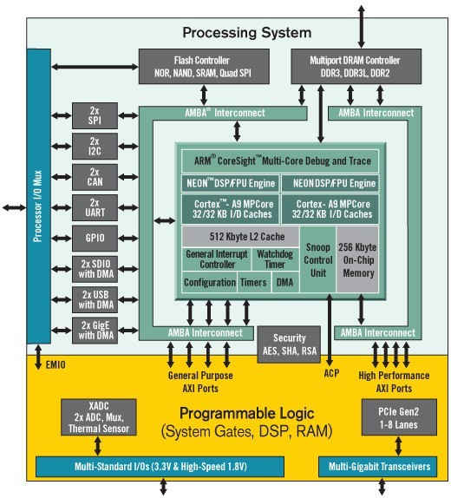
Zynq All programmable SoC
ARM Cortex-A9（PS part) Dual Core CPU +
28nm Artix-7/Kintex-7 based FPGA（PL part)
Notes:
Xilinx Zynq all programmable SoC has ARM Cortex A9 dual core CPU with programmable logic corresponding to Artix-7/Kintex-7. Recent Zynq-ultrascale+ has powerful ARM CPUs and programmable logic of high end FPGAs. Although it is rather for embedded systems, Linux runs on the ARM CPU, and the communication between CPU and FPGA can be done through the standard AXI bus.

Slide 21
Zynq-7000 All Programmable SoC
Processing System (PS)
MIO
2 USB
AXI Interconnect
2 GigE
APU
2 SD SDIO
ARM Cortex-A9
32/32 KB
I/D Cache
ARM Cortex-A9
32/32 KB
I/D Cache
GPIO
2 UART
512Kbyte L2 Cache
256Kbyte On-Chip Memory
2 CAN
Snoop Control Unit
2 I2C
2 SPI
AXI Interconnect
Flash Controller
(NOR, NAND,
SRAM, QSPI)
DRAM Controller
Programmable Logic (PL)
General Purpose
AXI ports
AXI ACP
High Performance
AXI ports
Notes:
Various types of I/O controllers are provided on the CPU part of Zynq. It can be also accessed from FPGA part.

Slide 22
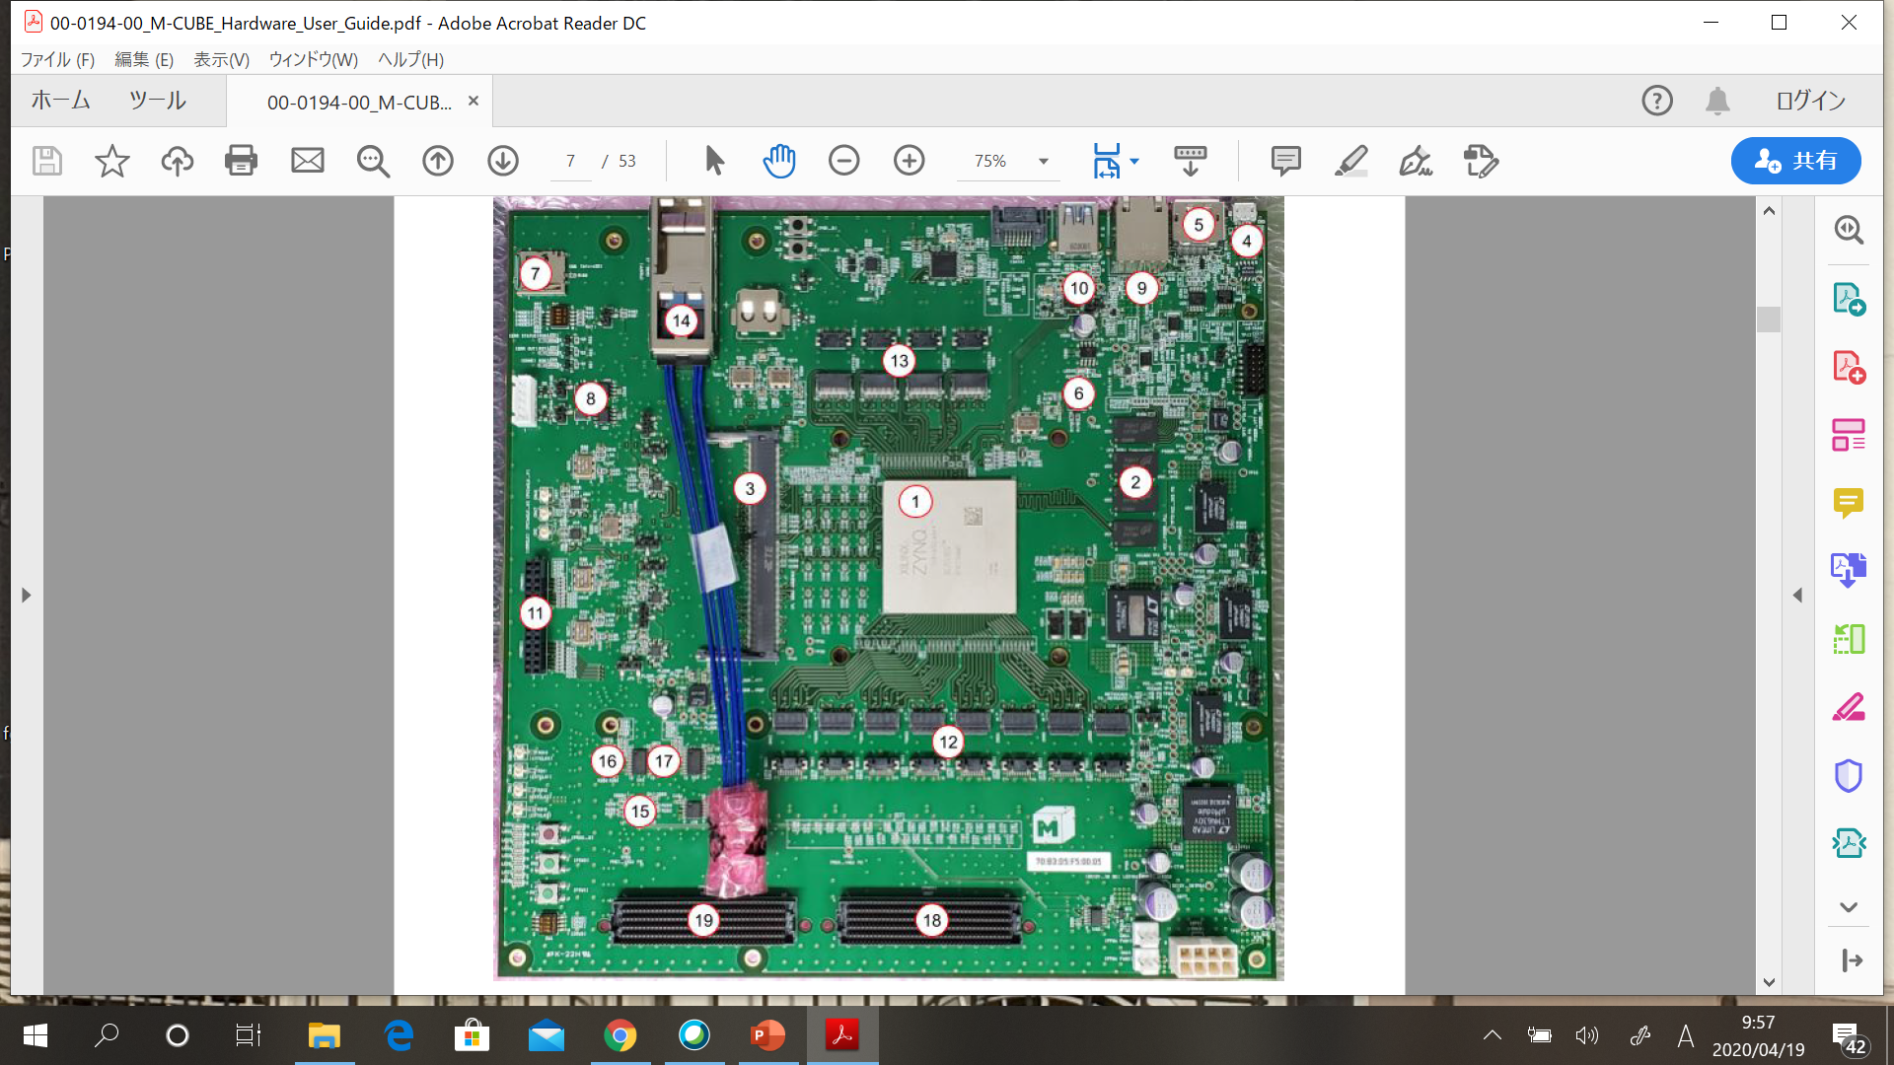
Zynq-Ultrascale+
Zynq-Ultrascale+
Zynq: xczu19eg-ffvc1760
GTH link x8
GTY link x4
DRAM 16Gb PL
4Gb PS
Gb Ethernet
USB 3.0

Slide 23
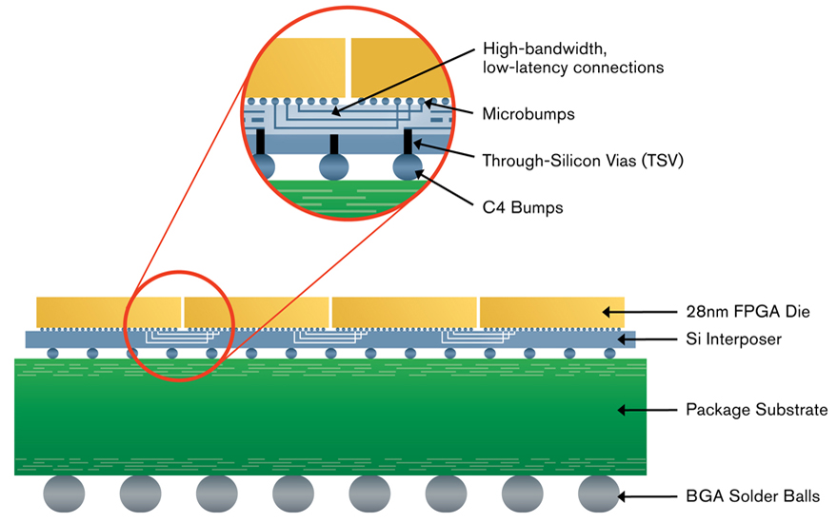
2.5D FPGA (http://www.xilix.com)
Notes:
Recent large scale FPGAs are implemented with multiple chips. on the silicon interposer. For example Zynq-ultrascale+ consists of two chips: one is ARM CPU and the other is FPGA. Even mid-renge Kintex Ultrascale uses 2.5D structure. Although the cost can be reduced, the wires between two chips often form the bottleneck.

Slide 24
Partial Reconfiguration
A part of configuration on FPGA can be replaced during operation.
.Since Virtex-4, most of Xilinx’s FPGAs provide it.
Intel’s FPGAs also provide it since Stratix V.
The FPGA is divided into the shell part which provides I/O, and user logic part which is partially reconfigured.
Easy to be implemented in recent FPGAs.
Notes:
Partial reconfiguration has been provided inmost recent FPGAs. It can make configuration of a part of FPGA, while other parts are working. By using this function, the FPGA is divided in the shell part provides I/O and user logic part which is partially reconfigured. It has become indispensable function for an FPGA as an accerelator.

Slide 25
Partial Reconfiguration
Clock Region Boundary
PRM
Reconf
Frame
PRM(Partial Reconfigurable Module) is placed on a fixed frame.
The problem is the interconnection between partial reconfiguration module
and static part.
Notes:
The area of partial reconfiguration has limitation.

Slide 26
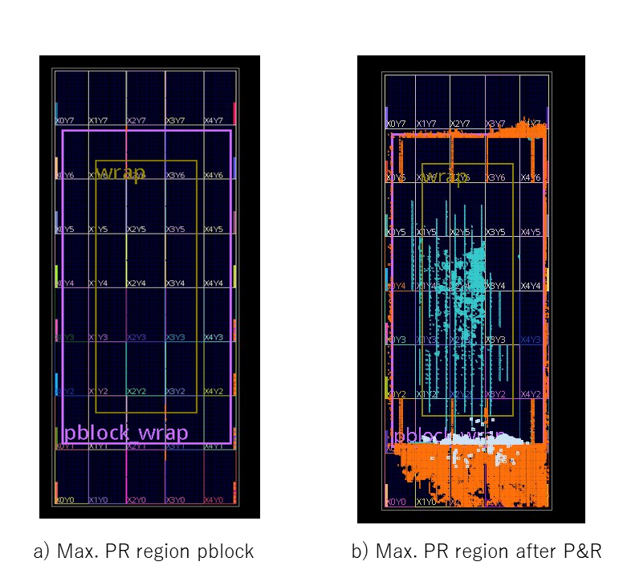
Partial Reconfiguration area for Xilinx Kintex Ultrascale
Notes:
This shows an example for Kintex Ultrascale

Slide 27
Partial Reconfiguration region
The case of Altera(Intel)’s Stratix V
Notes:
This is the case of Intel’s Stratix V.

Slide 28
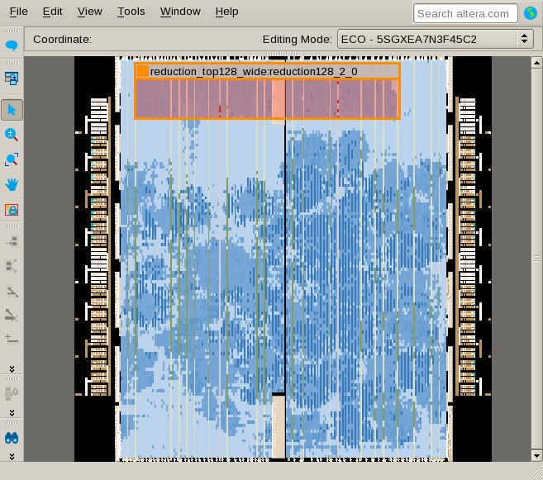
Replacing with another accelerator
Main switching fabrics works without stopping.

Slide 29
Reconfigurable System （Custom Computing Machine）
A target algorithm is executed directly with a hardware on SRAM-style FPGA/PLDs.
High performance of special purpose machines.
High degree of flexibility of general purpose machines.
A completely different execution mechanism from a stored program computers.
Notes:
Reconfigurable Systems or custom computing machines are systems in which a target algorithm is executed directly with a hardware on SRAM-style FPGA/PLDs. It aims to get high performance of special purpose machines with high degree of flexibility of general purpose machines. A completely different execution mechanism from a stored program computers is used.

Slide 30
ASIC
Refonfigurable Systems
Performance
FPGAs
High Performance and Flexibility
Design
A
Design
D
CPU
Design
B
CPU
Software
Design
C
for i=0; i<K; i++
X[i]=X[i+j]
.....
Flexibility
Notes:
This diagram explains the stand point of reconfigurable systems.

Slide 31
How to enhance the performance？
Performance enhancement by hardware execution itself
The overhead of software execution (Instruction fetch, data load to registers, and etc.)
The overhead of using fixed size data.
The overhead of using only two way branches.
However, these benefits are not so large, for embedded CPU and DSP
are highly optimized.
The key of performance improvement is parallel processing
Notes:
People might think that the performance of program can be improved just by implementing hardware. However, performance enhancement by hardware execution itself comes from these issues. However, their effect is not so large, since the embedded CPU and DSP are highly optimized. The key of performance improvement is parallel processing.

Slide 32
Parallel processing in reconfigurable systems
Various techniques can be used
SIMD execution
Pipelined structure
Systolic algorithm
Data driven control
Parallel execution other than calculation
Parallel data access using internal memory units
Parallel data transfer including I/O accesses
Notes:
In reconfigurable systems, various techniques which have been introduced in this lesson can be used.

Slide 33
SIMD (Single Instruction-stream/ Multiple Data-stream)-like calculation
The same instruction is applied to different data stream
In Reconfigurable Systems, the operation is not required to be same
（SIMD-like calculation）
Stream Data in
Stream Data out
Internal
Memory module
Processing part
Notes:
On reconfigurable systems, SIMD can be used widely. The processing can be changed since the operation can be embedded in the processing element.

Slide 34
Pipelined structure
The stream is divided and inserted periodically.
Stream Data １
Stream Data 5
Stream Data 3
Stream Data 4
Stream Data 2
Stream Data １
Stream Data 2
Internal
Memory module
Processing part
Notes:
Pipeline execution or stream execution can be also used. Since the I/O is often limited, this type of execution is widely used in reconfigurable systems.

Slide 35
Systolic Algorithm
Data x
Computational array
Data y
Data stream x，y are inserted with a certain interval.
When two streams meet each other, a calculation is executed.
→ Systolic: The beat of heart
Notes:
Systolic Algorithm is classic hardware algorithm frequently used on reconfigurable systems. It consists of homogeneous simple processors or cells which send and receive data from/to other cells periodically. The data stream x, and y are inserted with a certain interval. When two streams meet each other, a calculation is executed. Systolic means the beat of heart. It is also used in Googles’ domain specific system Tensor Processing Unit.

Slide 36
Band matrix multiply y=Ax
y0
y1
y2
y3
a11 a12 0 0
a21 a22 a23 0
0 a32 a33 a34
0 0 a43 a44
x0
x1
x2
x3
=
a
ｙｏ
ｙｉ
Ｘ＋
ｙｏ＝ ａ ｘ ＋ ｙ ｉ
x
Notes:
It is a cell which calculates the band matrix. Each cell receives x from left, y from right, and a from up. Then computer a x + y, and sends the result to left direction.

Slide 37
Band matrix multiply y=Ax
a11 a12 0 0
a21 a22 a23 0
0 a32 a33 a34
0 0 a43 a44
a23 a32
a22
a12 a21
a11
Ｘ ＋
x1
Notes:
First x1 means a11 at the central cell.

Slide 38
Band matrix multiply y=Ax
a11 a12 0 0
a21 a22 a23 0
0 a32 a33 a34
0 0 a43 a44
a33
a23 a32
a22
a12 a21
y1=a11x1
Ｘ ＋
Ｘ ＋
x2
x1
Notes:
The computation is done at the both side cells.

Slide 39
Band matrix multiply y=Ax
a11 a12 0 0
a21 a22 a23 0
0 a32 a33 a34
0 0 a43 a44
a34 a43
a33
a23 a32
a22
y1=a11 x1+
a12 x2
y2=a21 x1
X ＋
x3
x2
x1
Notes:
This time the central cell computes again.

Slide 40
Band matrix multiply y=Ax
a11 a12 0 0
a21 a22 a23 0
0 a32 a33 a34
0 0 a43 a44
a44
a34 a43
a33
a23 a32
y2=a21 x1+
a22 x2
Ｘ ＋
Ｘ ＋
x3
x2
Notes:
The side cells executes again.

Slide 41
Band matrix multiply y=Ax
a11 a12 0 0
a21 a22 a23 0
0 a32 a33 a34
0 0 a43 a44
a44
a34 a43
y2=a21 x1+
a22 x2+
a23 x3
a33
y3= a32 x2
Ｘ ＋
x3
x2
Notes:
The central cell computes in turn.

Slide 42
Data flow algorithm
ｄ
ｅ
The process is activated
with the available of tokens
(data)
ｃ
ｘ
ａ
ｂ
＋
＋
ｘ
（ａ＋ｂ）ｘ（ｃ＋（ｄｘｅ））
The overhead of synchronization is large.
Notes:
Data flow algorithm can be also used in reconfigurable system. The computation starts when both input data or tokens are ready.

Slide 43
Data flow analysis and hardware generation
Data Flow Graph
Data Flow Language
Configuration
Data
HDL
Description
Graph Decomposition
Suitable for automatic generation of hardware
Notes:
If the target data flow graph is extracted from some language, it is easy to be changed into HDL description and executed on reconfigurable systems.

Slide 44
Applications
No flexible program change
No IEEE standard floating point → FPGA as an accelerator
Not memory bounded
Image processing, analysis, pattern matching,
Logic simulation, Fault simulation.
Neural network simulation.
Encryption /Decryption
Queuing Model、Markov Analysis
Electric Power Flow
Censer processing
Efficient use of on the fly processing.
Communication control、Protocol control
Software radio
Notes:
They are representative application. Floating point computation is not suitable to reconfigurable systems, since the performance is difficult to be enhanced compared with that of GPUs. However, recent special FPGAs have competitive performance as an accelerators.

Slide 45
FPGA as an accelerator
Stratix 10
14nm Intel process
HyperFlex which enables GHz clock.
Registers are provided on the wires.
FP DSP modules with 10TFLOPS max.
ARM Cortex A53 Quad Core
Arria 10
20nm TSMC process
1.5TFLOPS max.
Open CL is used for programming
Notes:
Intel’s high end FPGAs have been designed to use an accelerator like GPUs. It provides a powerful floating point DSP modules up to 10TFLOPS at maximum. HyperFlex architecture which inserts registers on the wiring resource enables to use more than 1GHz system clock. They are supposed to be used for learning and recognition phase of Deep Learning.

Slide 46
Large Scale Reconfigurable Platforms
Stand-alone： SPLASH, RASH,BEE2
…
…
…
μP
RU
RU
RU
RU
RU
RU
Interconnection/Shared memory
Hetero nodes using homo cores： SRC6, SGI RASC
…
…
…
…
…
…
μP
μP
μP
μP
RU
RU
RU
RU
Interconnection/Shared memory
Homo node using hetero cores： Cray XD-1, XT4(XR-1)
…
…
…
…
μP
RU
μP
RU
μP
RU
μP
RU
Interconnection/Shared memory
Notes:
Large scale reconfigurable platforms are classified into three categories. The homo-node using hetero cores are recent trend for FPGA as an accelerator or FPGAs in cloud.

Slide 47
CRAY-XD1：
AMD Opteron
1board is consisting of 2CPUs＋FPGA（Virtex II Pro)
1 rack provides 6 boards
A high speed network called Rapid Array is used
Interconnection between FPGAs can be done with Rocket I/O

Slide 48
Microsoft’s Catapult
Rank computation for Web search on Bing.
Task Level Macro-Pipelining (MISD)
FE: Feature Extraction
FFE: Free Form Expression: Synthesis of feature values
MLS: Machine Learning Scoring
FE
FFE0
FFE1
Compress
MLS0
MLS1
MLS2
FPGA
FPGA
FPGA
FPGA
FPGA
FPGA
FPGA
FPGA
CPU
CPU
CPU
CPU
CPU
CPU
CPU
CPU
FPGA: Altera’s Stratix V
2-Dimensional Mesh is formed (8x6) for 1 cluster.

Slide 49
FPGA-in-Cloud
Host
PC
Host
PC
Host
PC
…
…
PCIe
PCIe
PCIe
FPGA
FPGA
FPGA
FPGA in the Cloud: Booting Virtualized Hardware Accelerators with OpenStack [FCCM2014]
Microsoft Catapult [ISCA2014 ][HEART2017]
FPGA Supervessel Cloud by IBM[ICFPT2016]
Amazon EC2 F1 Instance [https://aws.amazon.com/ec2/instance-types/f1/]
Not suitable for timing critical jobs.
The total cost becomes large.
High performance FPGAs are still expensive.
The size of FPGA is limited.
Multiple FPGAs cannot be used together.
Notes:
Recently, there are a lot of activities around FPGA-in-cloud. Most of conventional FPGA-in-cloud uses high performance FPGA boards each of which is attached into its own host. They are connected with network through its host. This natural way has two problems. First, the total cost becomes large, since a number of high performance expensive FPGAs are used. Second, the user can use each FPGA independently but cannot use multiple FPGAs together, since they are separated thorough its host.

Slide 50
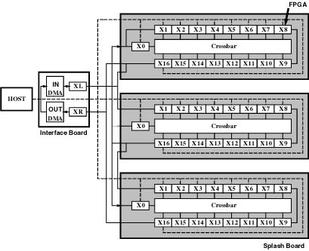
Splash-2 (Arnold et.al 92)
String matching, Image processing, DNA matching, 330 times faster than the supercomputer Cray-II.
Systolic algorithm
VHDL, Parallel C
Annapolis Micro Systems（WILDFIRE)
Notes:
The root of stand-alone multi-FPGA system would be Splash/Splash-2. It uses systolic algorithm.

Slide 51
Flow-in-Cloud (FiC) overview
Host CPU
FiC-SW
I/O board
KCU1500
FPGA
FPGA
FPGA
FPGA
STDM switch
STDM switch
STDM switch
STDM switch
Circuit switching network
High Speed Serial Links
FPGA
FPGA
FPGA
FPGA
STDM switch
STDM switch
STDM switch
STDM switch
HLS modules
Notes:
Flow-in-Cloud is consisted of tightly connected FPGA boards each of which provides a cost-efficient FPGA. A host CPU is connected with an I/O board. It is consisting of Xilinx’s XCU1500 and small daughter boards. 9.9G firefly cables are provided to connect other boards. Each board is called FiC-SW, but it provides HLS acceleration module in its partial reconfiguration region.

Slide 52
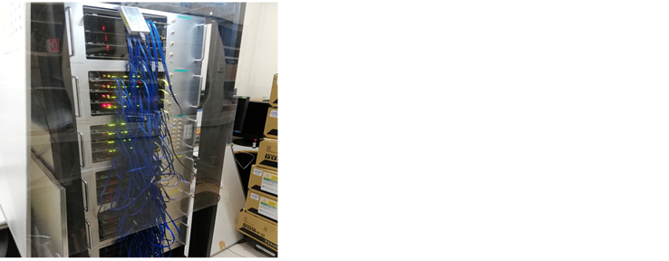
FiC(Flow in Cloud)
Stand-alone multi-FPGA
system with 24 boards
Notes:
This is a photo of FiC working with 24 boards.

Slide 53
Historical flow of computer systems
ENIAC
EDVAC、EDSAC
IBM machines
Reconfigurable
Machine
RISC, Intel’s microprocessors
Notes:
Reconfigurable machines are another possibility of the computer architecture.

Slide 54
Exercise
There is a systolic array which multiplies 8 x 8 tri-diagonal matrix A with a size 8 vector x. Compute the number of clock cycles for the multiply. Here, the time when the first element of x reaches to the left-most array is assumed to be time 0.
Notes:
Here is today’s exercise.

